Slide 1
Progress Report
Ken

Slide 2
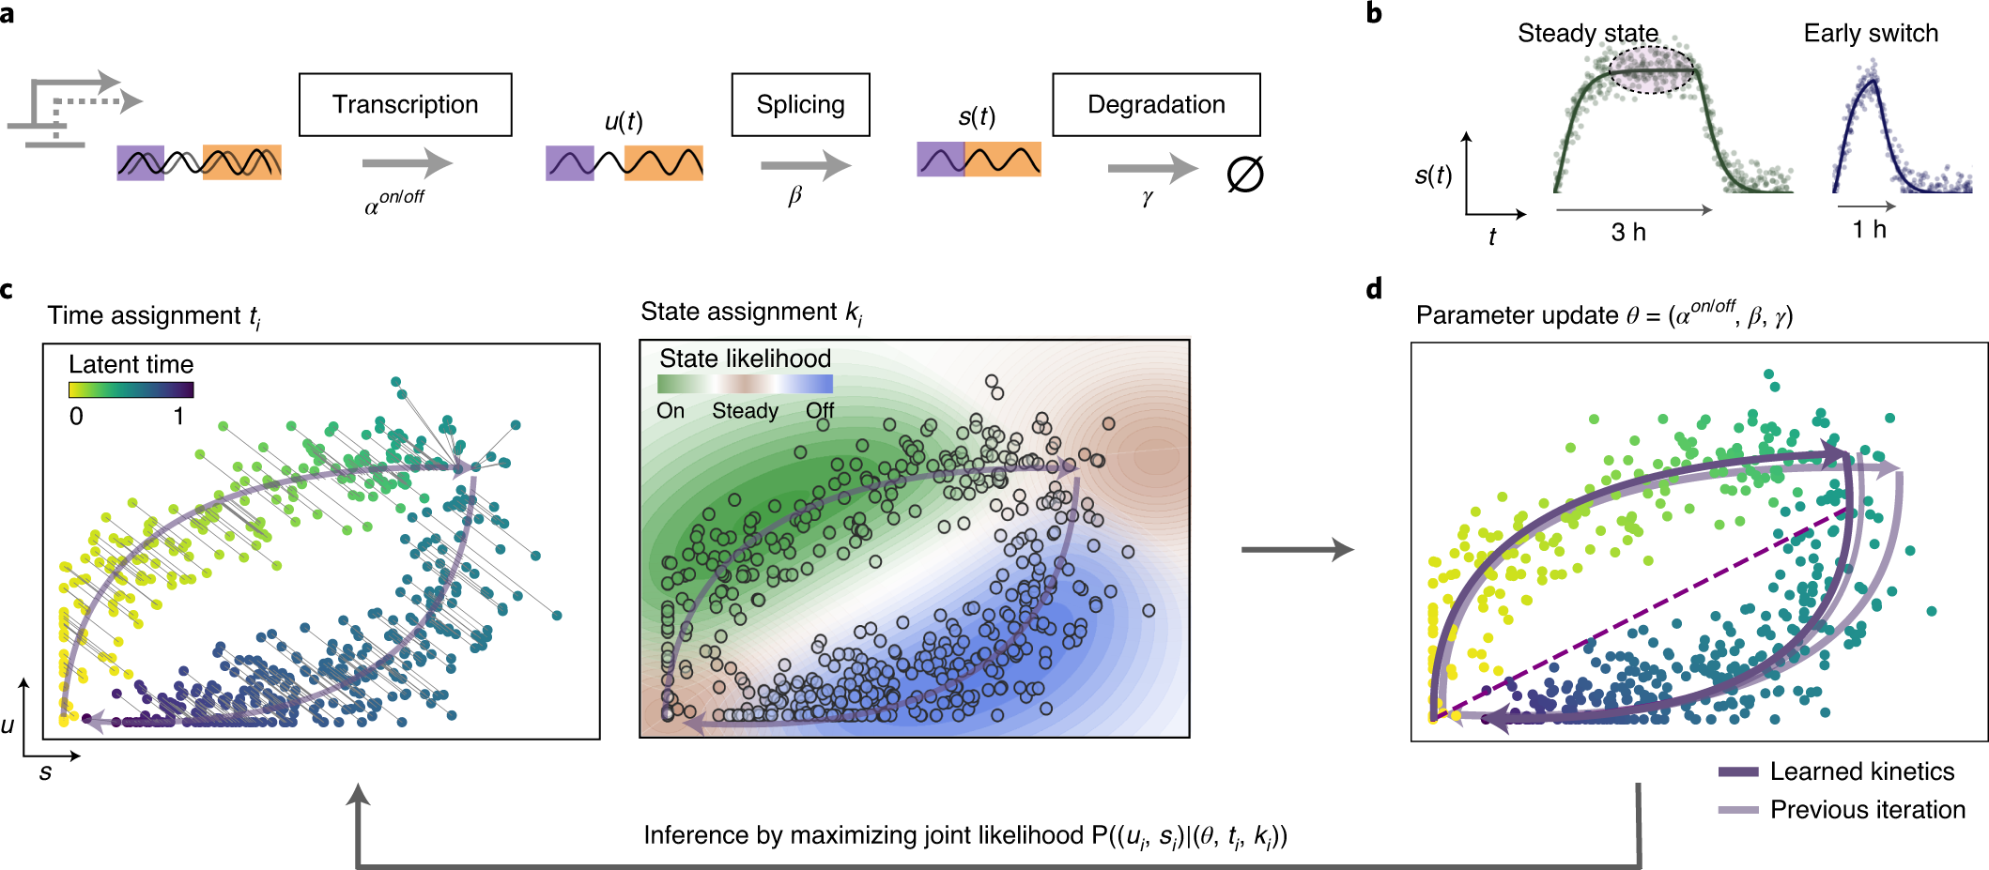

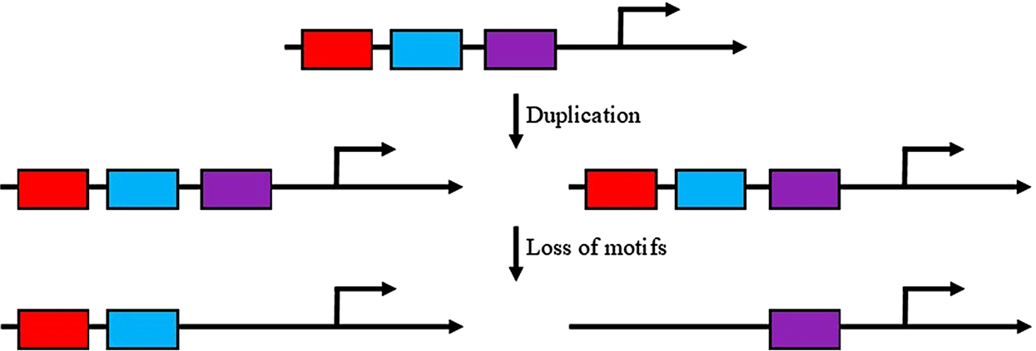
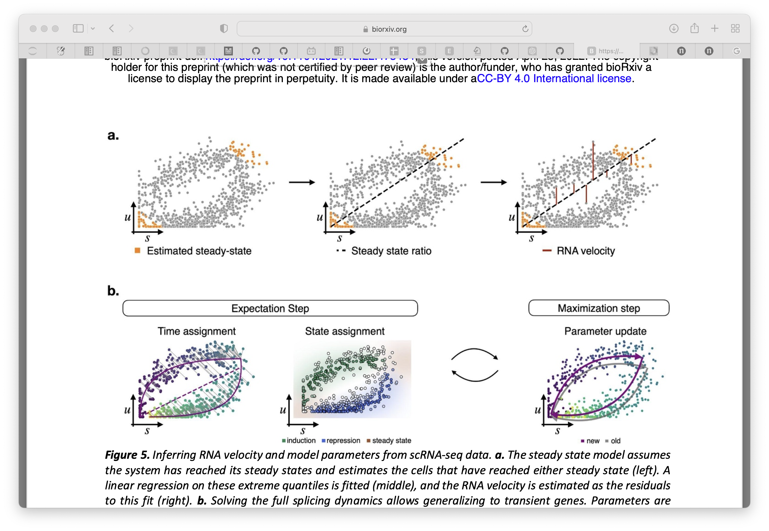

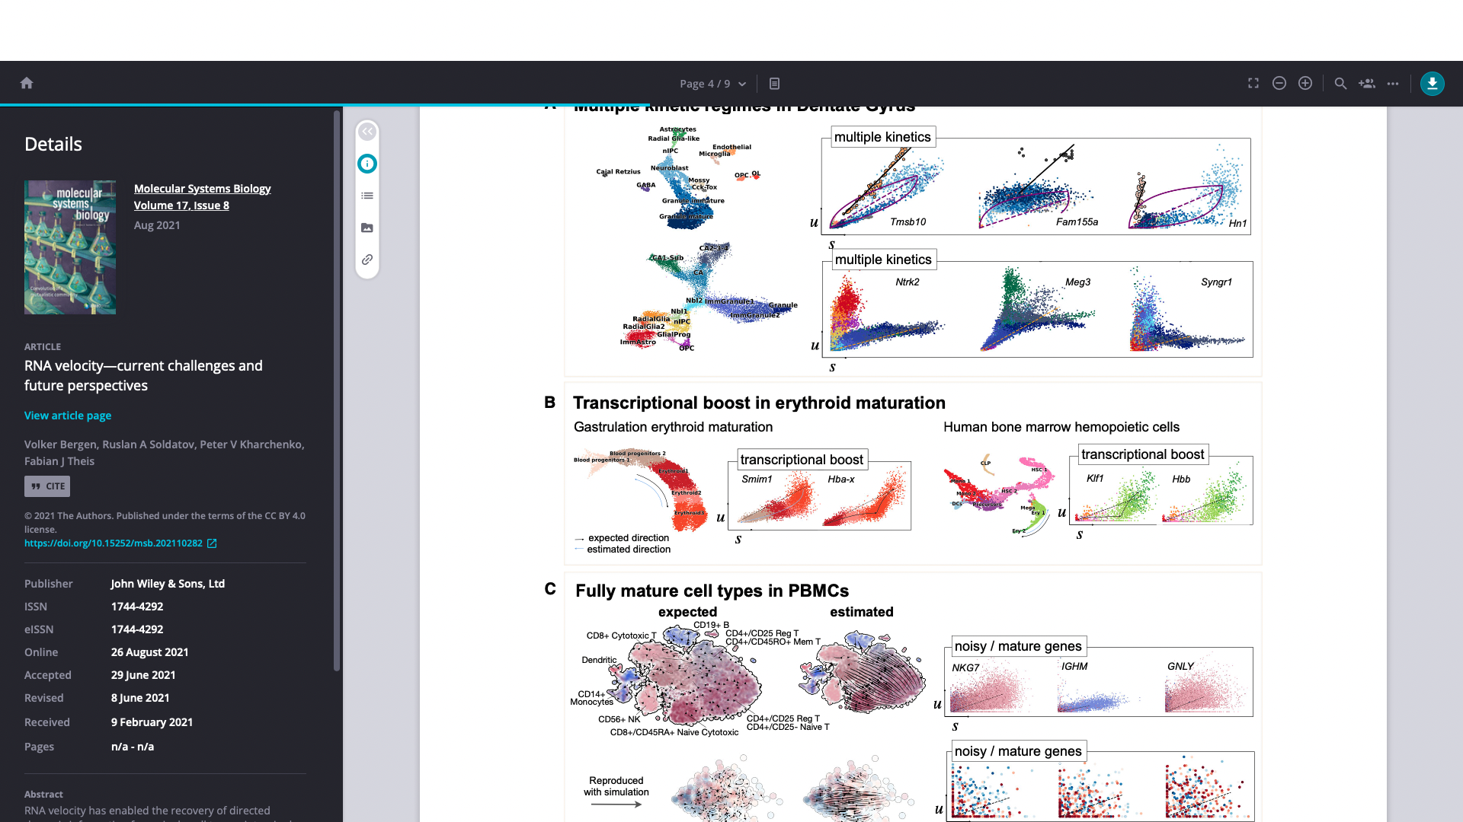

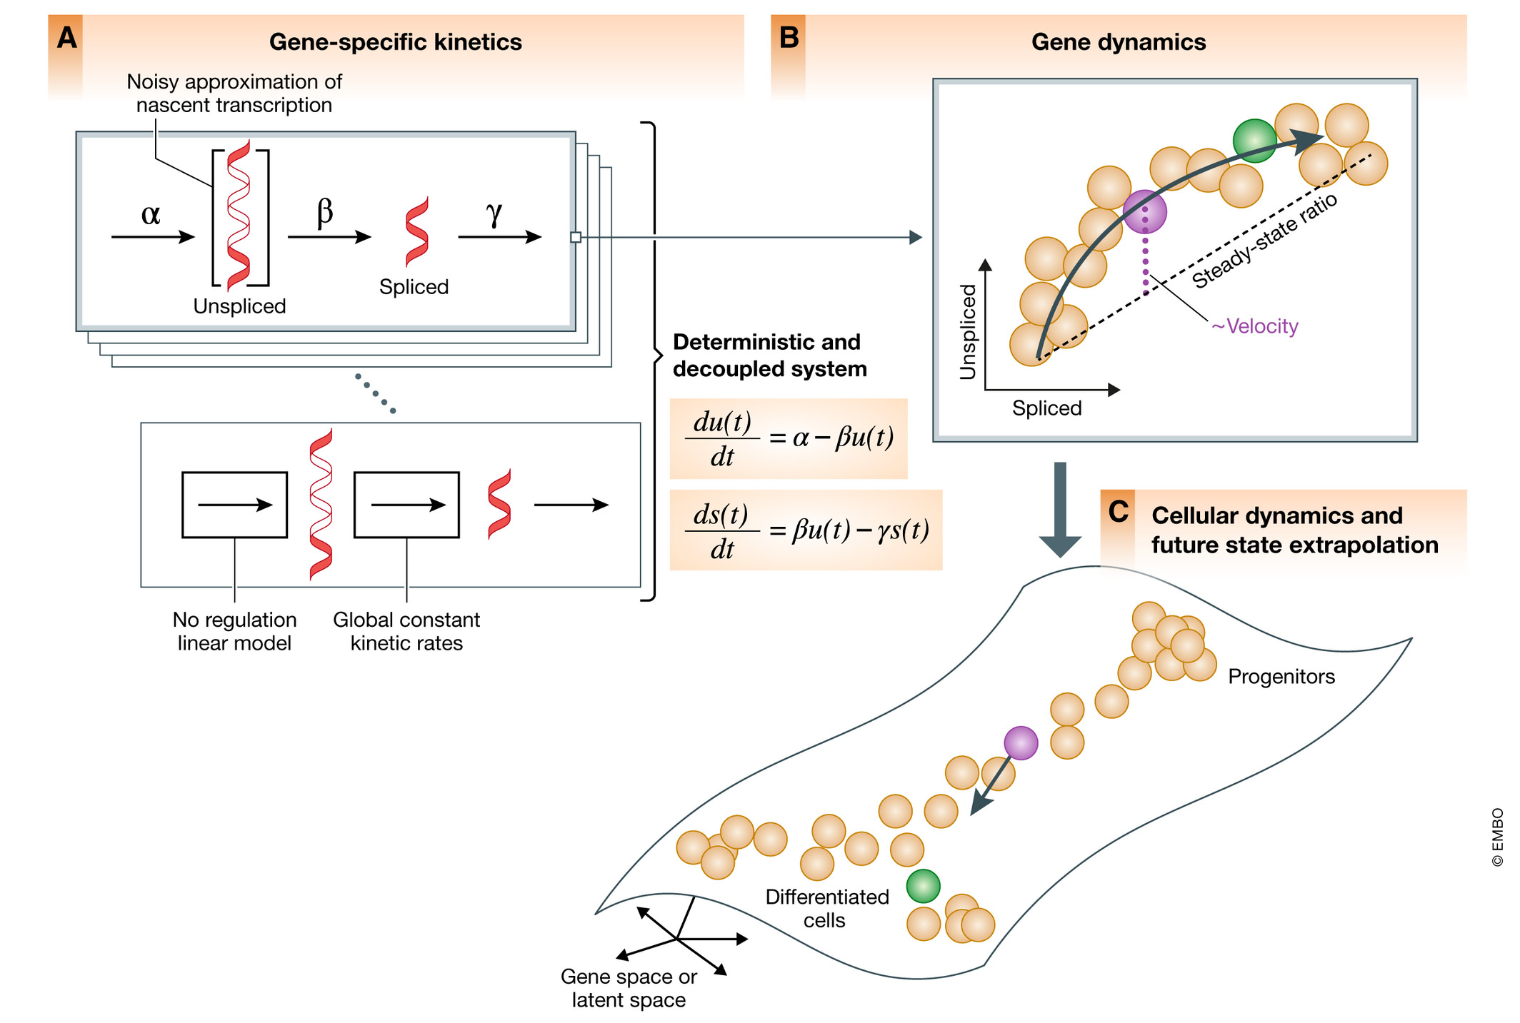
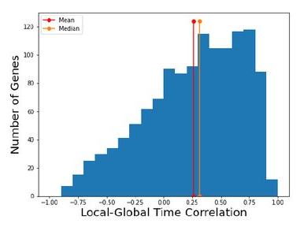
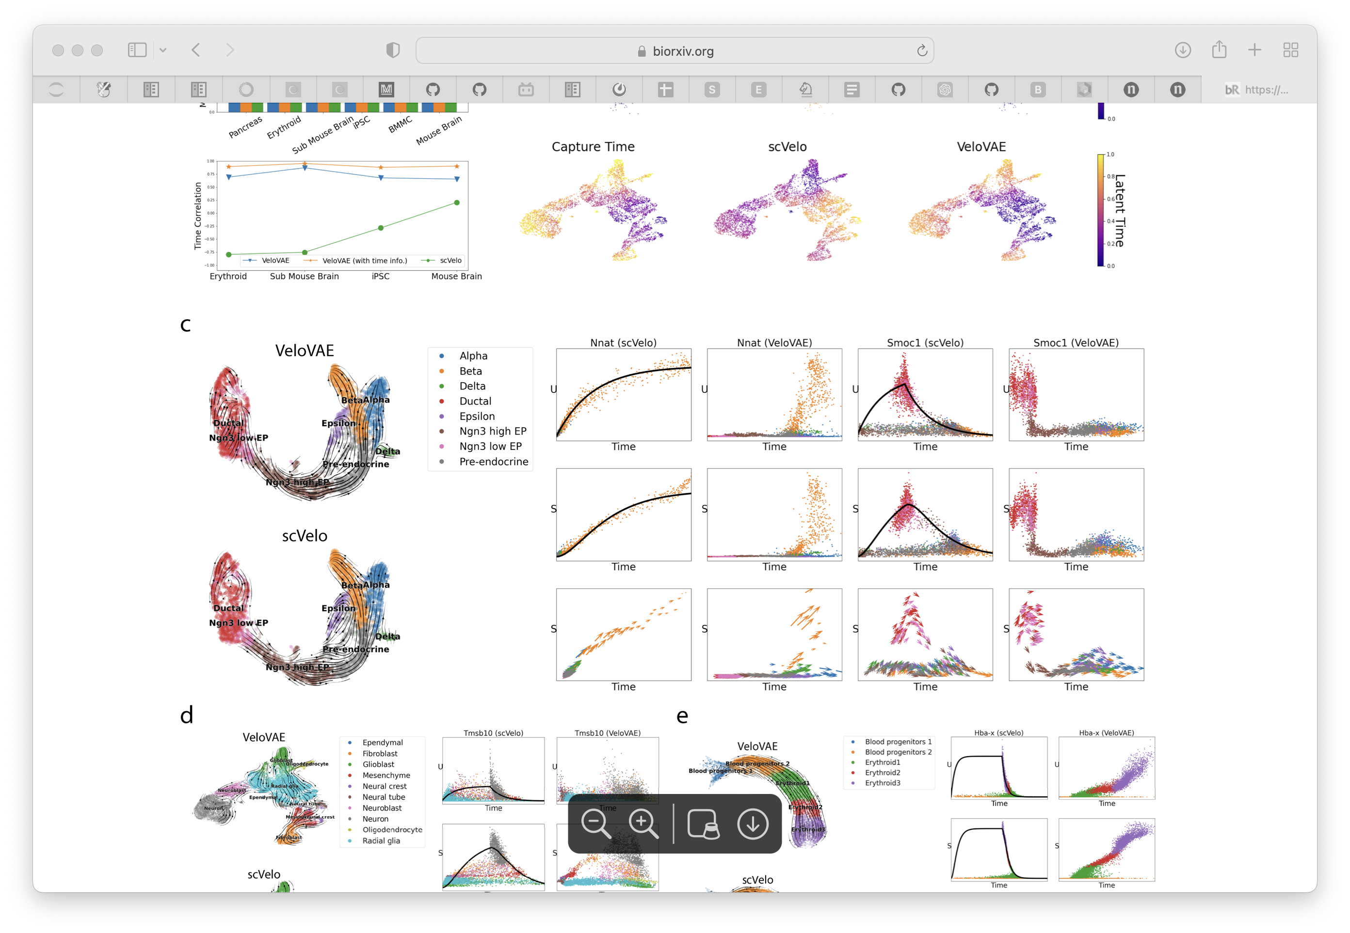
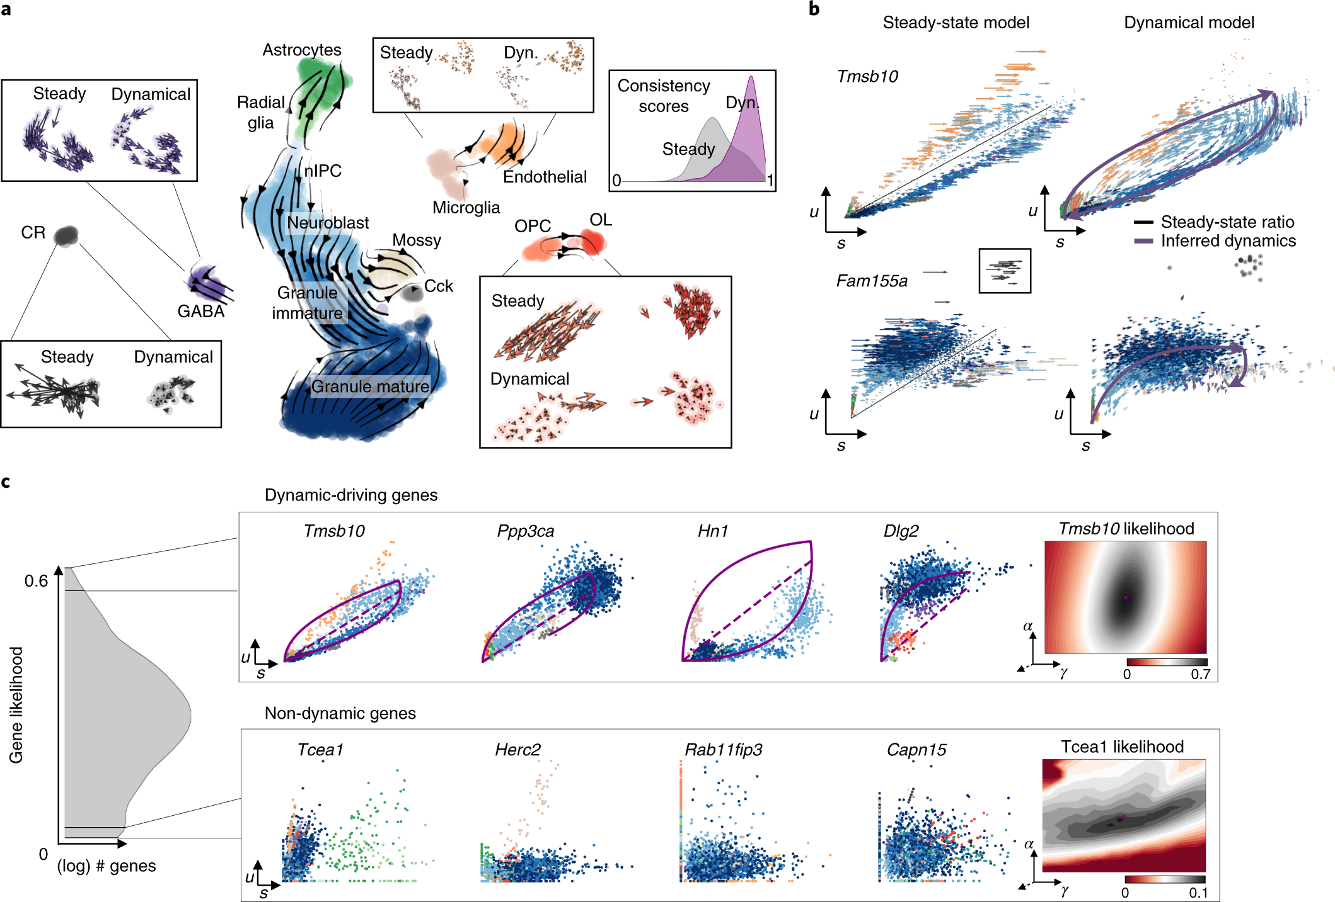

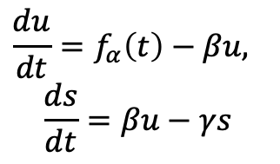
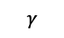
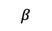
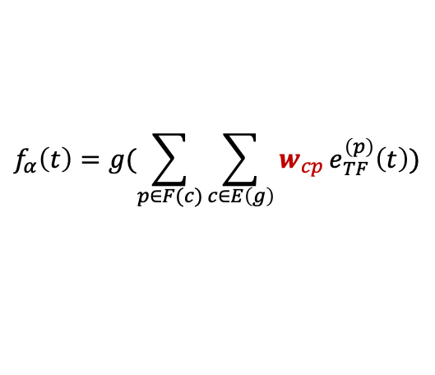
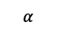
Current limits in RNA velocity
Multivariate Models towards systems dynamics (RegVelo)
TF2
Modeling the regulatory dynamics of target gene
TF1
$$α$$
$$β$$
$$γ$$
$$\frac{du}{dt}=f_{α}\left(t\right)−βu,$$
$$\frac{ds}{dt}=βu−γs$$
1. Steady state assumption
2. Generalized transient system
CRE1
CRE2
CRE3
Target genes
$$f_{α}\left(t\right)=g(\sum_{p∈F(c)}{\sum_{c∈E\left(g\right)}{w_{cp}}e_{TF}^{\left(p\right)}\left(t\right))}$$
La Manno, et al. 2019, Weiler, et al. 2022
Bergen, et al. 2020
Transcriptional bursting induced by change of transcription rate
TF: Transcription Factor
CRE: cis-regulatory elements
Supervised by: Marius & Fabian
Potential application of RegVelo
Bergen, et al. 2021
1. A better velocity estimation and fate probability prediction
later induction
First induction
“First induction” ->
Gene specific latent time -> a heuristic estimation of global latent time
2. Understanding the underlying regulatory mechanisms of lineage differentiation/priming
Gu, et al. 2022
Each gene fit independently, ignoring everything about regulation relationship
3. Generate new trajectory and test the effects of TF-perturbation the lineage differentiation.
Gu, et al. 2022

Slide 3
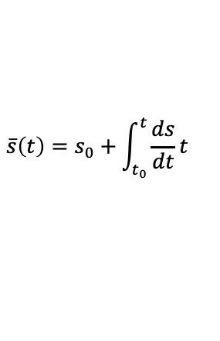
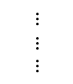
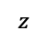
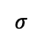
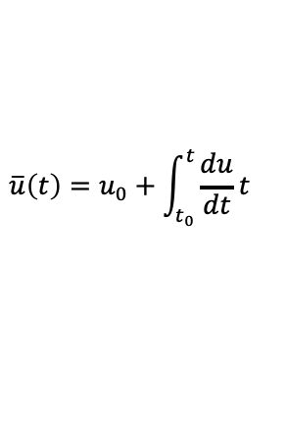
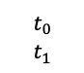
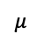
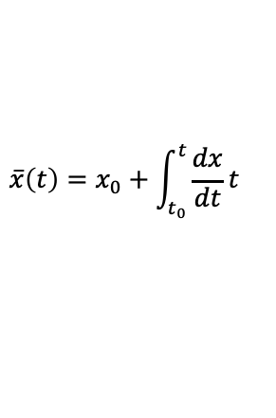
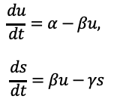
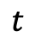
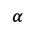
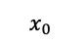
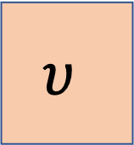
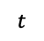

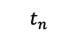
Implementation.1 RegVelo-global
Mini-batch ($n=128$)
Transcription Rate Encoder
$$α$$
$$x_{0}$$
$$\frac{du}{dt}=α−βu,$$
$$\frac{ds}{dt}=βu−γs$$
Numerical solver block
$$\overline{u}\left(t\right)=u_{0}+\int_{t_{0}}^{t}{\frac{du}{dt}t}$$
Spliced
$$\overline{s}\left(t\right)=s_{0}+\int_{t_{0}}^{t}{\frac{ds}{dt}t}$$
$$z$$
$$t$$
$$μ$$
$$t$$
$$t_{0}$$
$$t_{1}$$
$$υ$$
Unspliced
$$⋮$$
$$⋮$$
$$⋮$$
$$σ$$
$$t_{n}$$
Latent Time Encoder
$$\overline{x}\left(t\right)=x_{0}+\int_{t_{0}}^{t}{\frac{dx}{dt}t}$$
$$Loss=ReconstructionLoss+{ReconstructionLoss}_{ODE}+KL divergence$$
$$+{latent space distance}_{z}$$
torchdiffeq.odeint
Use correlation matrix to initialize the transcription rate encoder

Slide 4
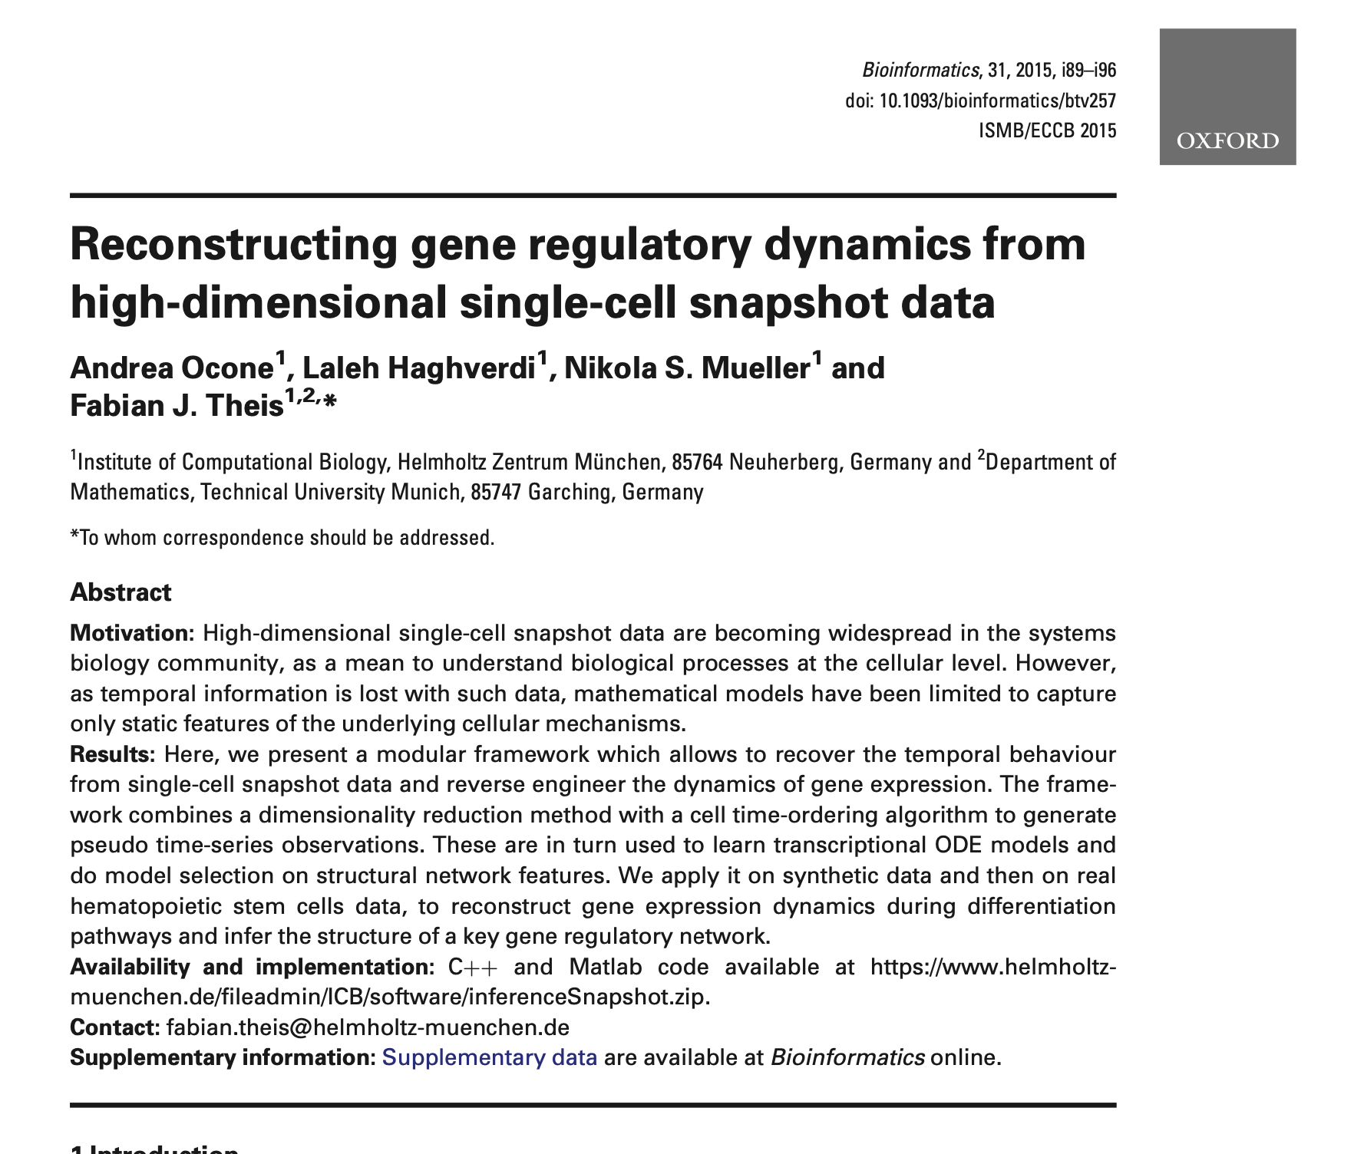
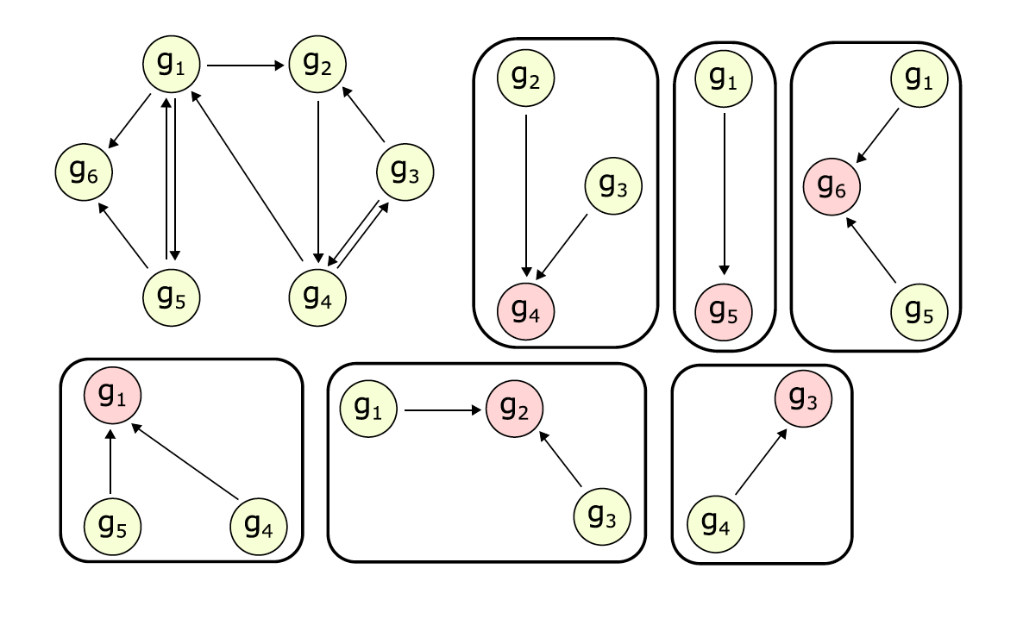
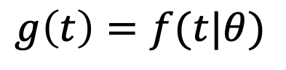
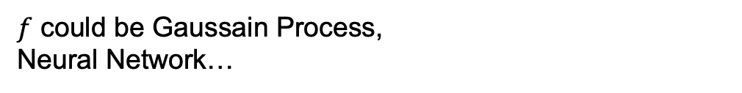
Implementation.2 RegVelo
Keypoints of estimation framework
A decoupled systems
Gene (velocyto, scVelo) -> Regulon (RegVelo)
Decouple the system using condition independence
“Emulator” for regulator
$$g\left(t\right)=f(t|θ)$$
$f$ could be Gaussain Process,
Neural Network…
Georgoulas, et al. 2012
Decouple into “regulons”:
A target gene and a set of regulators(TF & CREs)

Slide 5
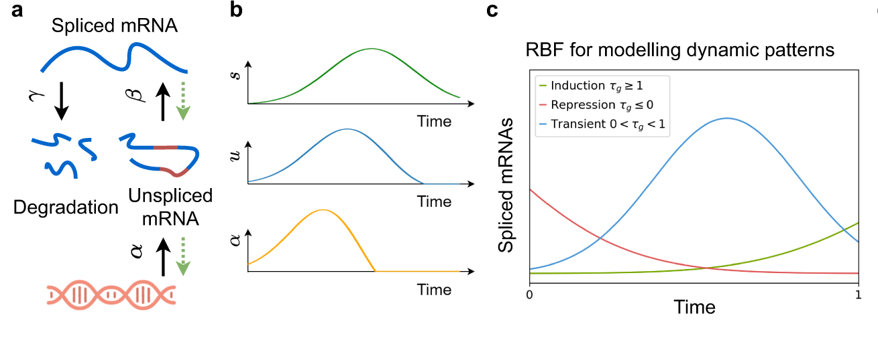
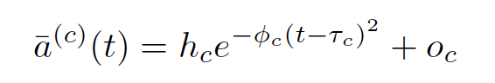
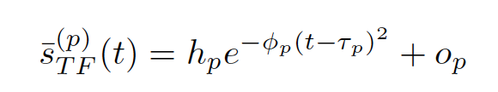
Using RBF to emulating the dynamics of regulators
Cis-regulatory elements (ATAC):
Regulator gene expression (spliced):

Slide 6
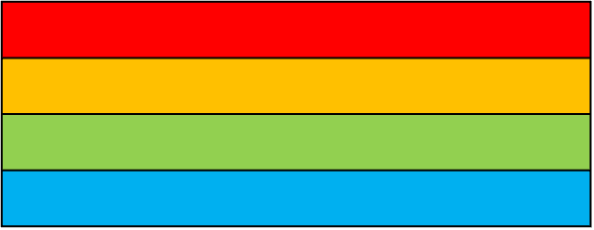
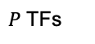
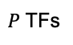
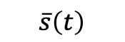
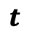

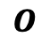
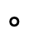
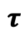
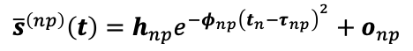
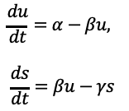
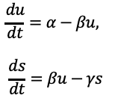
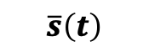

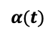
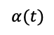
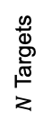






Assume all targets share the same latent time
Emulator Module
Velocity Encoder Module
$P$ TFs
$$α(t)$$
$$h$$
$$\overline{s}\left(t\right)$$
$W$
$$\frac{du}{dt}=α−βu,$$
$$\frac{ds}{dt}=βu−γs$$
Spliced
$$φ$$
$P$ TFs
$$τ$$
$$O$$
Unspliced
$$t$$
Assume all targets has different, specific latent time
$N$ Targets
$$t$$
TF1 Expression
Velocity Encoder Module
$P$ TFs
Element wise product
$$α(t)$$
$$W$$
$$\overline{s}\left(t\right)$$
$$\frac{du}{dt}=α−βu,$$
$$\frac{ds}{dt}=βu−γs$$
$$t_{1}({target}_{1})$$
Spliced
$$∘$$
$N$ Targets
$$O$$
TF1 Expression
$$τ$$
$$φ$$
$$h$$
$${\overline{s}}^{\left(np\right)}\left(t\right)=h_{np}e^{−φ_{np}{\left(t_{n}−τ_{np}\right)}^{2}}+o_{np}$$
Unspliced
$$t_{2}({target}_{2})$$

Slide 7

Estimation procedure:
1. Interpolate the dynamics of the regulators use top-down manner (emulators) using parametric function (RBF) or Gaussian process.
2. For each subsystem, estimate kinetic parameter and regulatory parameters

Slide 8







Numerical Solver Module
$$\overline{u}\left(t\right)=u_{0}+\int_{t_{0}}^{t}{\frac{du}{dt}t}$$
$$\overline{s}\left(t\right)=s_{0}+\int_{t_{0}}^{t}{\frac{ds}{dt}t}$$
Parallel ODE solver

Slide 9













RegVelo: Decouple the network through Modularization
Emulator Module
Velocity Encoder Module
Numerical Solver Module
$$h$$
$$α$$
$$\overline{u}\left(t\right)=u_{0}+\int_{t_{0}}^{t}{\frac{du}{dt}t}$$
$$φ$$
$$W$$
$$φ$$
$$\frac{du}{dt}=α−βu,$$
$$\frac{ds}{dt}=βu−γs$$
$$τ$$
$$O$$
$$h$$
$$O$$
$$\overline{s}\left(t\right)=s_{0}+\int_{t_{0}}^{t}{\frac{ds}{dt}t}$$
Parallel ODE solver
Spliced
# cells
$$μ$$
$$z$$
Regulon Specfic
Latent time
Unspliced
# target genes
$$σ$$
Cell Representation Encoder
Latent Time Decoder
Fit Likelihood
To the parameter of h, phi, tao, O, all four need broadcast to form a matrix with (t*g), (or if we need to model target gene specific regulation)
We also could just fit a matrix with (t*g) without broadcast to fit a target gene specific regulator coefficient. Then infer a module specific latent time.

Slide 10













RegVeloVI: Introduce phase assumption (induction, repression, repression steady state)
$$α_{k}^{(n)} \left(t\right)=\left\{\begin{aligned}f\left(\sum_{p}{{{w_{np}\overline{s}}_{TF}}^{\left(p\right)} (t)}\right), k=\left\{1\right\}, \\ 0, k=\{2,3\}\end{aligned}\right.$$
K = 1 induction,
K = 2 repression,
K = 3 repression steady state
Emulator Module
Velocity Encoder Module
Numerical Solver Module
$$h$$
$$α$$
$$\overline{u}\left(t\right)=u_{0}+\int_{t_{0}}^{t}{\frac{du}{dt}t}$$
$$φ$$
$$W$$
$$φ$$
$$\frac{du}{dt}=α−βu,$$
$$\frac{ds}{dt}=βu−γs$$
$$τ$$
$$O$$
$$h$$
$$O$$
$$\overline{s}\left(t\right)=s_{0}+\int_{t_{0}}^{t}{\frac{ds}{dt}t}$$
Parallel ODE solver
Spliced
Latent Time Decoder
# cells
$$μ$$
$$z$$
Regulon Specfic
Latent time
Unspliced
# target genes
$$σ$$
Cell Representation Encoder
Fit Likelihood
State assignment
# cells
Regulon Specfic
State assignment
# target genes

Slide 11


Benchmark on simulated datasets
Dataset-1
Dataset-2
# Genes: 138
# Cells: 1000
# targets: 130
# regulators: 87
# links: 373
# Genes: 119
# Cells: 1000
# targets: 117
# regulators: 73
# links: 319

Slide 12




VeloVI
RegVelo
RegVelo-global
RegVeloVI

Slide 13




Benchmark the reconstruction performance among all methods
RMSE on training set
5-fold CV RMSE
Add state assignment would help reconstruction
Dataset-1
Dataset-2

Slide 14




RegVeloVI perform better than other velocity model in general
Compare with ground truth velocity on cell level
Mean with ground truth velocity on cell level
Compare with ground truth pseudotime
Compare with ground truth cell fate probability

Slide 15

RegVeloVI would predict a good GRN if have a good initialization
Regulatory edges weight predictive accuracy

Slide 16






A good GRN initialization would help correct wrong vector flow
Initialize through correlation
Initialize through GRNBoost2
Initialize through CellOracle
Regulatory edges weight predictive accuracy
Compare velocity inference accuracy
Correlation with ground truth latent time

Slide 17





A good GRN initialization would help correct wrong vector flow
Method | Correlation with ground truth
VeloVI | 0.9662
RegVeloVI (Cor) | 0.9625
RegVeloVI (GRNBoost2) | 0.9654
RegVeloVI (CellOracle) | 0.9710
Ground truth
VeloVI
RegVeloVI (Cor)
RegVeloVI (GRNBoost2)
RegVeloVI (CellOracle)

Slide 18






Early stopping is all you need when train deep generative velocity model
Reconstruct loss of regulator (emulation)
Reconstruct loss of regulator (emulation)
v
v
Model Parameters:
Encoder/time decoder/state decoder neural network parameters
Emulation parameters
GRN
Kinetic parameters (e.g. beta, gamma)
Early stopping
Total loss (reconstruction loss + KL divergence)
Benchmark Velocity
Benchmark GRN
v
Early Stopping
Converge

Slide 19
Future work
try two stages training:
Stage1: early stopping when emulation loss is converge
Stage2: Frozen encoder/time decoder parameters and emulator parameters, fine tuning other parameters to ensure emulation would not become worse but would keep minimize the total loss.
Apply on real dataset (e.g. celloracle example dataset with backbone GRN learn from ATAC-seq dataset)
Benchmark the gene perturbation prediction (celloracle give a good start point to test our model)
How to further extend model consider the ATAC information and sequence motif feature under multiomics setting.
For now we only predict the target gene velocity, combine ON/OFF assumption to model the dynamics of other genes (with no upstream regulators)?
……

Slide 20



